Slide 1

Youth Program Database
By Max Simmer, Rachel Gordon, Taylor Fischer, Kadin Suga, and David Sheleru
Notes:
Rachel's Slide

Slide 2

Introduction
Centers for Social and Educational Development (CSED)
Midwest-based nonprofit organization that provides professional, leadership, cultural, and faith-based educational programs
Consists of a network of several centers that offer programing for youth in middle school through college
Centers serve as hubs for series of ongoing classes and some special events such as workshops, service opportunities, and retreats
YouthProgram Database
Solution to store data regarding student attendees and their participation, classes and events offered, and the staff and volunteers assisting with the various programs
Input provided by Mary, a staff member at CSED
Notes:
Kadin's slide

Slide 3
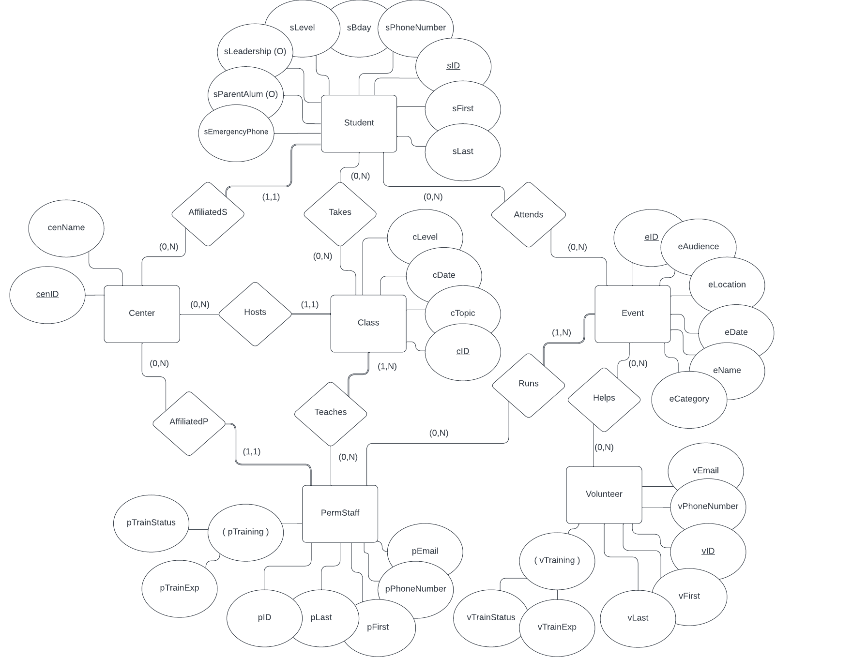
ER Diagram
Notes:
Max's Slide

Slide 4
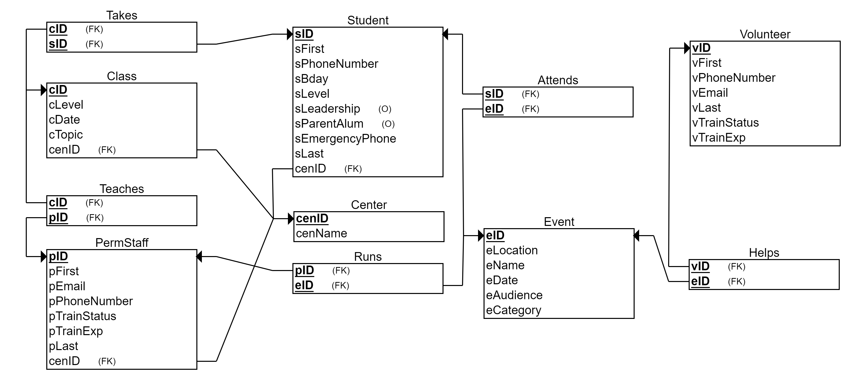
Relational Schema
Notes:
David's Slide

Slide 5
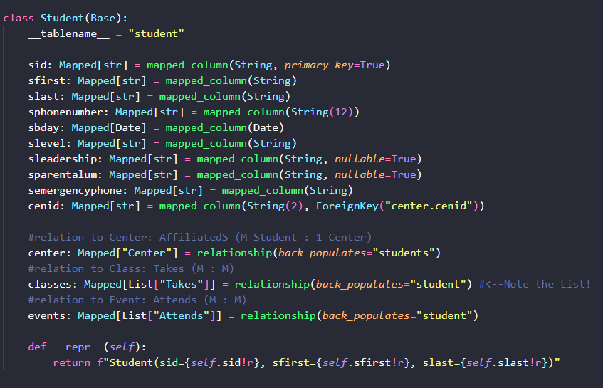

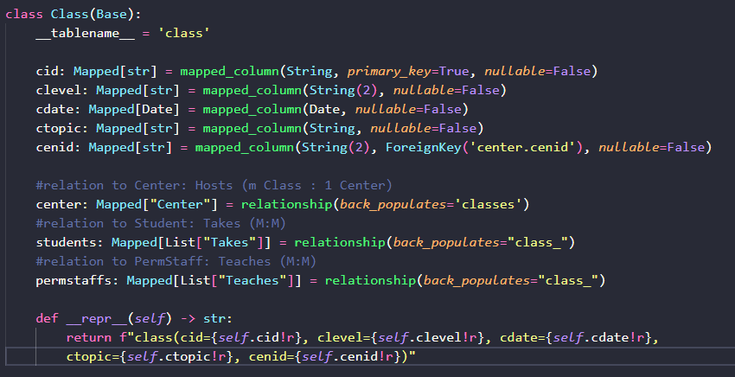
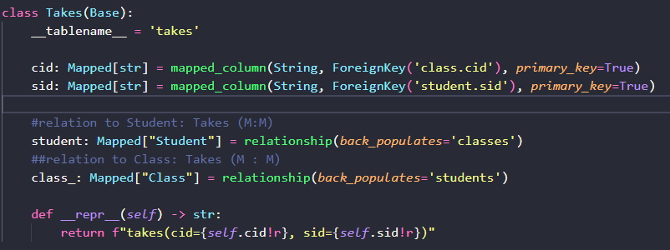
ORM Implementation
Full ER diagram
N:N relationships using association object
Notes:
Taylor's slide
-association object from documentation
-from there, move on to the ORM queries

Slide 6
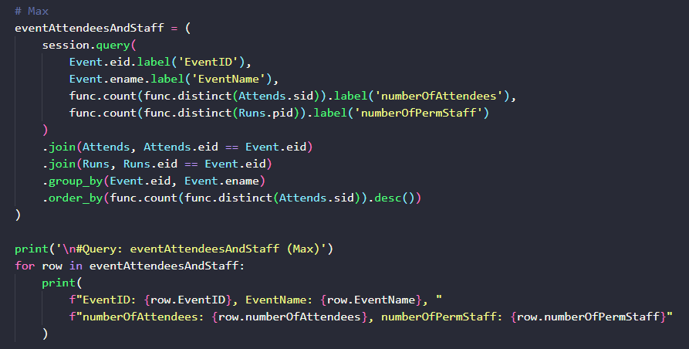
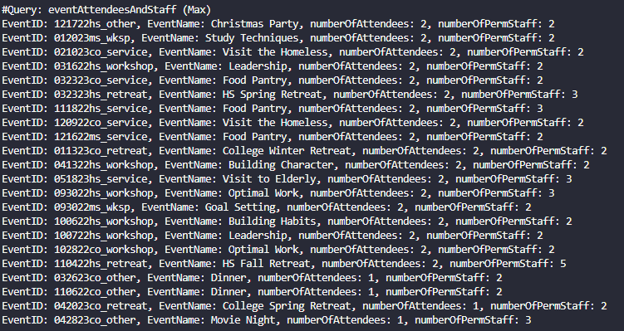
EventAttendanceAndStaff Query (Max)

Slide 7
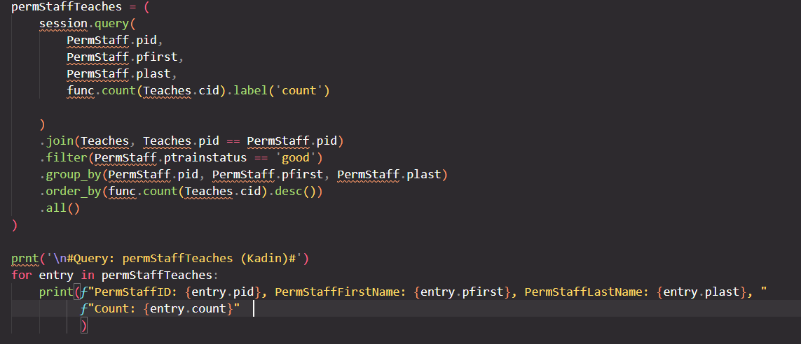
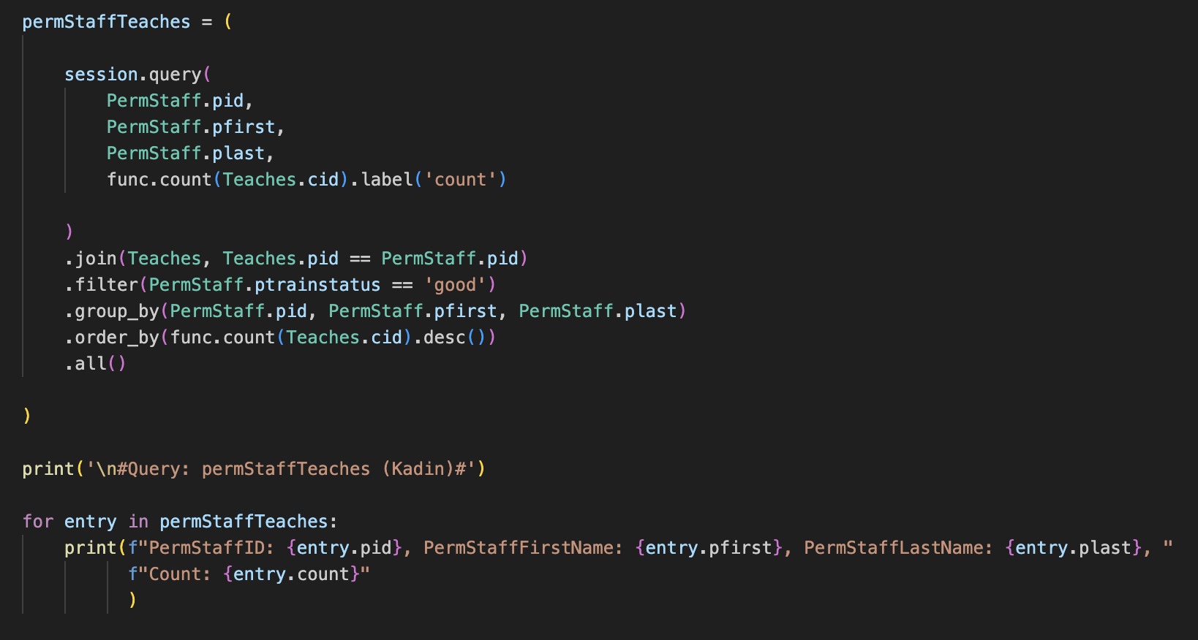
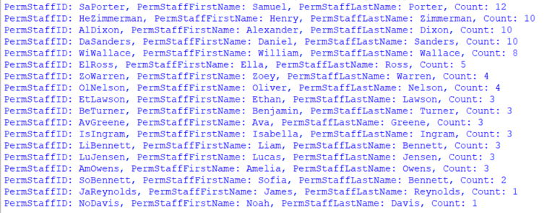
NumClassesTaught Query (Kadin)

Slide 8
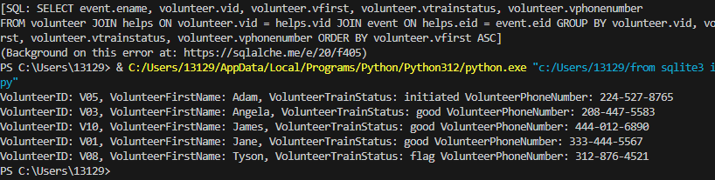
EventVolunteer Query (David)
eventVolunteer = ( eventVolunteer = ( ​ select( ​ Event.ename, ​ Volunteer.vid, ​ Volunteer.vfirst, ​ Volunteer.vtrainstatus, ​ Volunteer.vphonenumber, ​ ) ​ .join(Helps, Volunteer.vid == Helps.vid) ​ .join(Event, Helps.eid == Event.eid) ​ .order_by(Volunteer.vfirst.asc()) ​ ) ​ print('\n#Query: eventVolunteer (David)#') ​ event_volunteers = session.execute(eventVolunteer) ​ for entry in event_volunteers: ​ print(f"Eventname: {entry.ename},VolunteerID: {entry.vid}, VolunteerFirstName: {entry.vfirst}, VolunteerTrainStatus: {entry.vtrainstatus} VolunteerPhoneNumber: {entry.vphonenumber}") ​
Description: Extracts volunteer ID, first name, training status, and phone number for volunteers helping at each event and orders by first name in ascending order.

Slide 9
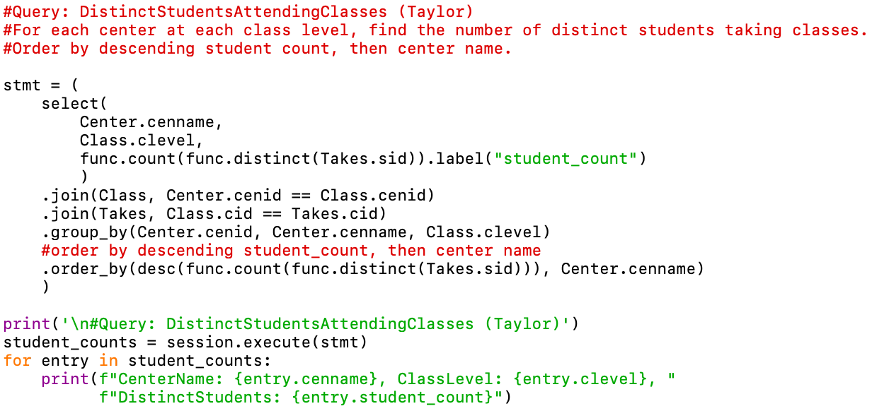
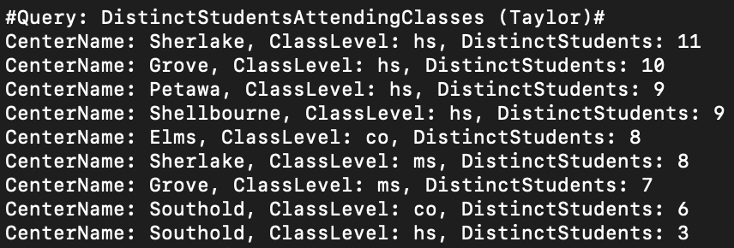
DistinctStudentsAttendingClasses Query (Taylor)

Slide 10
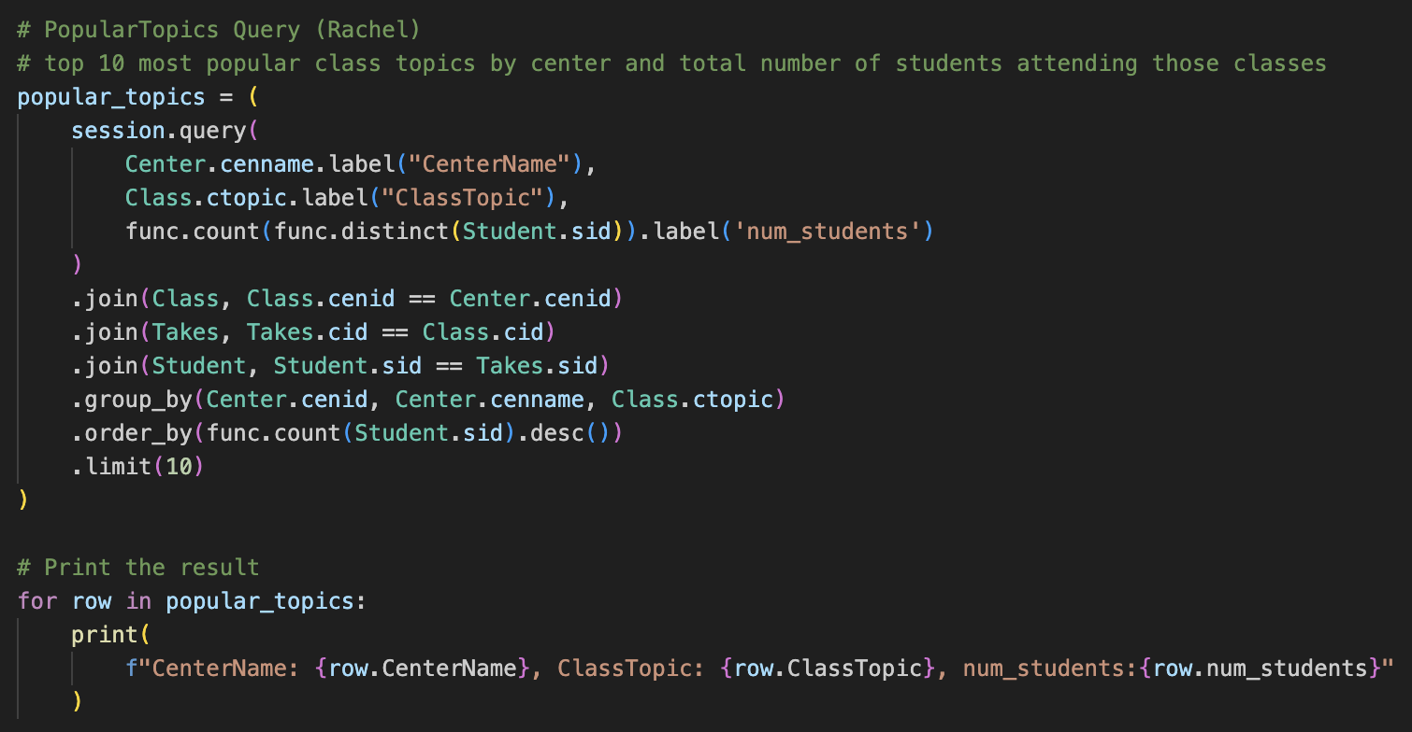
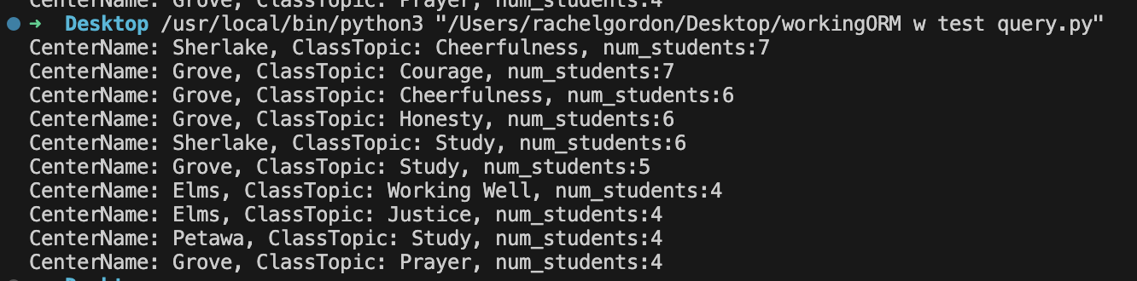
PopularTopics Query (Rachel)

Slide 11
Thank You! Questions?

Slide 12
Description of the Organization
Student: ID, first name, last name, phone number, birthday, email, and emergency contact phone number.
Additional categories include a student’s level in school (e.g. high school or college), whether a student is involved in a leadership group, and whether a student’s parent(s) is an alum of CSED programs.
Each student is mainly affiliated with one center, but a center can be affiliated with many students.
Center: physical branch locations within the CSED network that serve as hubs for classes. Each center has a name and a unique ID.
Each center can host many different series of class sessions.
Class session: ID, series level indicating the intended student audience, date the session was held, and the topic presented.
There is no maximum class size, and students can take multiple sessions (of the same series).
Each session is taught by one or more staff members.

Slide 13
Description of the Organization
Event: ID, name, date, location, event category, and intended student audience.
Students can attend multiple special events, and there is not a set attendance capacity.
Events are run by one or more permanent staff, often with the help of volunteers.
Permanent staff: ID, first name, last name, email, and phone number.
Each permanent staff member can teach multiple class sessions or run multiple events.
Each staff member is affiliated with one center, with no limit to the number of staff per center.
Staff members must maintain satisfactory training, so training status and the date of training expiration are also recorded.
Volunteer: ID, first name, last name, email, and phone number.
The training status and the next training expiration date are also recorded for volunteers.
Volunteers can help with special events.

